Slide 1
NCTU IEE 5046 高頻電路設計與實驗 Finalizing PCB Design
Lecturer: Professor Yu-Jiu Wang
TA: 李道一michael@rfvlsi.ee.nctu.edu.tw
Document coauthor: Jon-Jin Chen

Slide 2

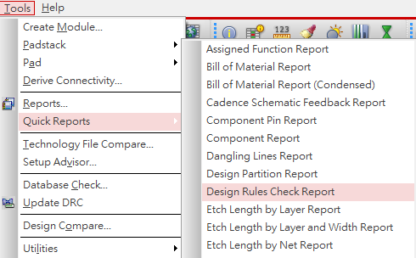
Design Rule Checking (DRC)
按按鈕
看報告
做修正

Slide 3
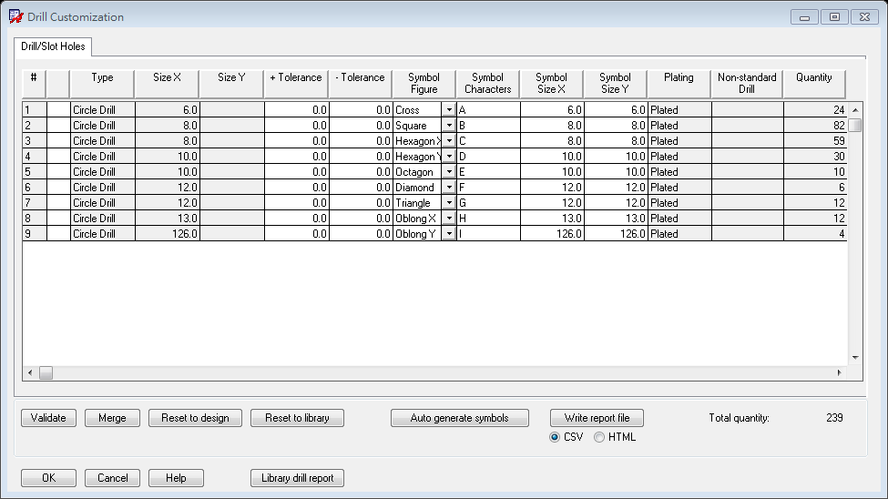
Drill Legend - Drill Customization
Drill Legend is not required for panelization (併版)
設定鑽孔標記的圖例
Manufacture -> NC->Drill Customization

Slide 4
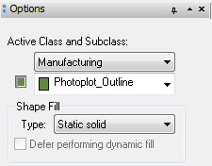
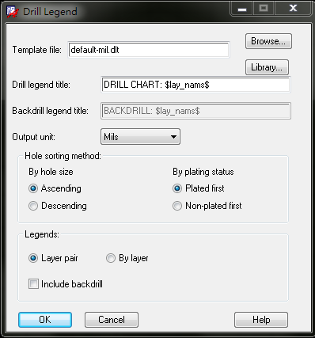
Drill Legend
每一層都鋪好後, 應該就不會有淡藍色的細線(有的話要檢查有沒有錯)
接下來如果使用的元件有鑽孔, 就要列出鑽孔表
Manufacture -> NC -> Drill Legend
OK後把表放到圖上, 如果有很多個表一開始會重疊，此時先把框框拉開(只有框框,裡面的線不會動),排列成想要的形狀後
再重新呼叫Drill Legend, 這時候他就會自己排好了
排好以後選擇Add Rectangle, 用Manufacturing的Photoplot_Outline
把板子還有Drill Legend 通通框起來

Slide 5
Drill Legend - *.dlt設定檔範本
預設放在C:\Cadence\SPB_16.3\share\pcb\text\nclegend
可以把裡面的dlt檔複製，然後用文字編輯器修改
若要併版，則不需要在個別的PCB加入Drill Legend

Slide 6
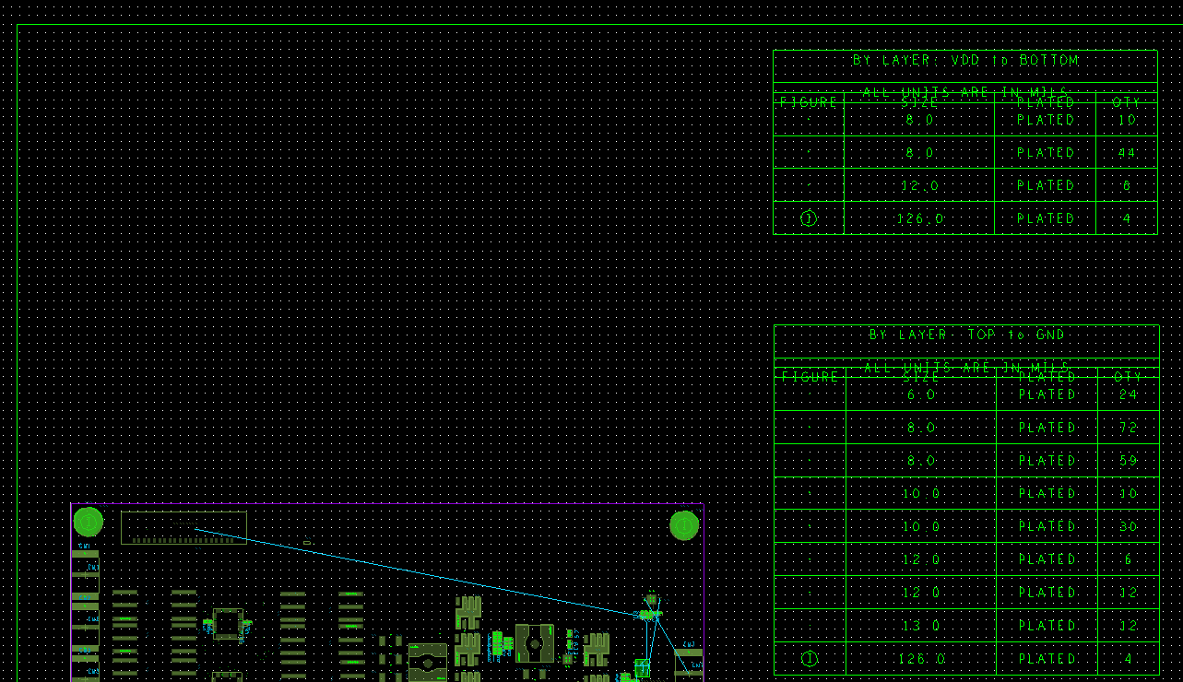
Drill Legend
Photoplot Outline
Drill Legend

Slide 7
Gerber RS-274X Artwork
The file format used by PCB industry software to describe the images of a printed circuit board (copper layers, solder mask, legend, drill holes, etc.).
The de-facto industry standard for printed circuit board image transfer
G04 Film Name: paste_top* G04 Origin Date: Thu Sep 20 15:54:22 2007* G04 Layer: PIN/PASTEMASK_TOP* %FSLAX55Y55*MOIN*% %IR0*IPPOS*OFA0.00000B0.00000*MIA0B0*SFA1.00000B1.00000*%
%ADD28R,.11X.043*% %ADD39O,.07X.022*%
...
%AMMACRO19* 21,1,.0512,.0512,0.0,0.0,45.*% %ADD19MACRO19*%
%LPD*%

Slide 8
Gerber RS-274X Artwork
For double sided PCB, following Gerber files are usually submitted to fabrication company
Top Copper Etching
Bottom Copper Etching
Top Soldermask
Bottom Soldermask(optional)
Top Silkscreen
Bottom Silkscreen
If you are designing paste stencil, following Geber files are needed
Top Pastemask
Bottom Pastemask

Slide 9

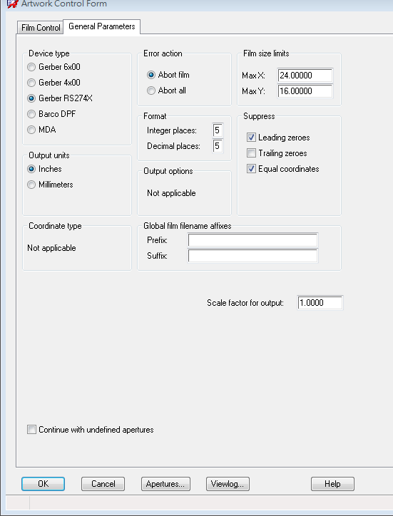
Artwork(底片)產生
按按鈕
設定精確度，要比design的小數位數多一位。
選擇GERGER 274X格式

Slide 10
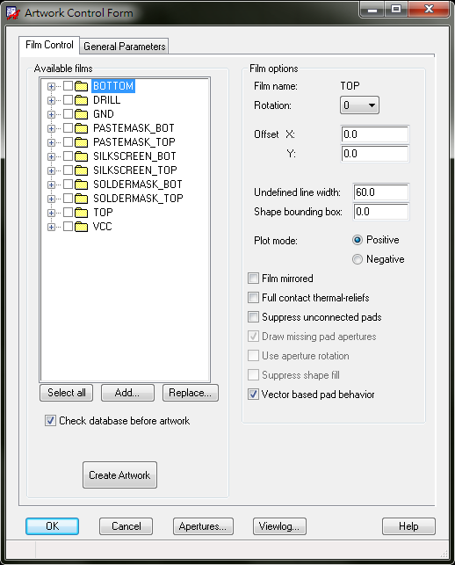
Artwork(底片)產生(cont’d)
最後要輸出成Artwork
Manufacture -> Artwork
預設只有板子所以先按Replace
每一層Layer需要和cross section 設定成一樣正片或負片
選擇FILM_SETUP.txt (內容如下)
接著選Select all再選Create Artwork並按OK
就完成了

Slide 11
FILM_SETUP.txt
(axlfcreate "SILKSCREEN_BOT" '(0 0 0 30 0 1 0 0 0 1 0 0 1) '("REF DES/SILKSCREEN_BOTTOM" "PACKAGE GEOMETRY/SILKSCREEN_BOTTOM" "MANUFACTURING/PHOTOPLOT_OUTLINE" "BOARD GEOMETRY/OUTLINE" "BOARD GEOMETRY/SILKSCREEN_BOTTOM" ))
(axlfcreate "PASTEMASK_BOT" '(0 0 0 30 0 1 0 0 0 1 0 0 1) '("PIN/PASTEMASK_BOTTOM" "MANUFACTURING/PHOTOPLOT_OUTLINE" "BOARD GEOMETRY/OUTLINE" ))
(axlfcreate "VCC" '(0 0 0 30 0 0 0 1 0 1 0 0 1) '("MANUFACTURING/PHOTOPLOT_OUTLINE" "BOARD GEOMETRY/OUTLINE" ))
(axlfcreate "SOLDERMASK_TOP" '(0 0 0 30 0 1 0 0 0 1 0 0 1) '("VIA CLASS/SOLDERMASK_TOP" "PIN/SOLDERMASK_TOP" "PACKAGE GEOMETRY/SOLDERMASK_TOP" "MANUFACTURING/PHOTOPLOT_OUTLINE" "BOARD GEOMETRY/OUTLINE" "BOARD GEOMETRY/SOLDERMASK_TOP" ))
(axlfcreate "SOLDERMASK_BOT" '(0 0 0 30 0 1 0 0 0 1 0 0 1) '("VIA CLASS/SOLDERMASK_BOTTOM" "PIN/SOLDERMASK_BOTTOM" "PACKAGE GEOMETRY/SOLDERMASK_BOTTOM" "MANUFACTURING/PHOTOPLOT_OUTLINE" "BOARD GEOMETRY/OUTLINE" "BOARD GEOMETRY/SOLDERMASK_BOTTOM" ))
(axlfcreate "SILKSCREEN_TOP" '(0 0 0 30 0 1 0 0 0 1 0 0 1) '("REF DES/SILKSCREEN_TOP" "PACKAGE GEOMETRY/SILKSCREEN_TOP" "MANUFACTURING/PHOTOPLOT_OUTLINE" "BOARD GEOMETRY/OUTLINE" "BOARD GEOMETRY/SILKSCREEN_TOP" ))

Slide 12
FILM_SETUP.txt
(axlfcreate "PASTEMASK_TOP" '(0 0 0 30 0 1 0 0 0 1 0 0 1) '("PIN/PASTEMASK_TOP" "MANUFACTURING/PHOTOPLOT_OUTLINE" "BOARD GEOMETRY/OUTLINE" ))
(axlfcreate "GND" '(0 0 0 3 0 0 0 1 0 1 0 0 1) '("ANTI ETCH/GND" "VIA CLASS/GND" "PIN/GND" "MANUFACTURING/PHOTOPLOT_OUTLINE" "ETCH/GND" "BOARD GEOMETRY/OUTLINE" ))
(axlfcreate "DRILL" '(0 0 0 1 0 0 1 0 0 0 1 0 0 1) '("MANUFACTURING/NCLEGEND-BL-3-4" "MANUFACTURING/NCLEGEND-BL-2-3" "MANUFACTURING/NCLEGEND-BL-1-2" "MANUFACTURING/PHOTOPLOT_OUTLINE" "MANUFACTURING/NCDRILL_LEGEND" "MANUFACTURING/NCDRILL_FIGURE" "BOARD GEOMETRY/OUTLINE" ))
(axlfcreate "BOTTOM" '(0 0 0 30 0 1 0 0 0 1 0 0 1) '("VIA CLASS/BOTTOM" "PIN/BOTTOM" "MANUFACTURING/PHOTOPLOT_OUTLINE" "ETCH/BOTTOM" "BOARD GEOMETRY/OUTLINE" ))
(axlfcreate "TOP" '(0 0 0 30 0 1 0 0 0 1 0 0 1) '("VIA CLASS/TOP" "PIN/TOP" "MANUFACTURING/PHOTOPLOT_OUTLINE" "ETCH/TOP" "BOARD GEOMETRY/OUTLINE" ))
(axlfcreate "VDD" '(0 0 0 0 30 0 0 0 0 0 0 1 1) '("ETCH/VDD" "PIN/VDD" "VIA CLASS/VDD" ))

Slide 13
FILM_SETUP每個欄位的意義
Field 1 = ROTATION
Field 2 = OFFSET X
Field 3 = OFFSET Y
Field 4 = UNDEFINED LINE WIDTH (e.g. 30=30mil)
Field 5 = SHAPE BOUNDING BOX
Field 6 = PLOT MODE
Field 7 = MIRRORED
Field 8 = FULL CONTACT THERMAL RELIEFS
Field 9 = SUPPRESS UNCONNECTED PADS
Field 10= DRAW MISSING APERTURES
Field 11= USE APERTURE ROTATION
Field 12= FILL OUTSIDE SHAPES
Field 13= VECTOR BASED PAD BEHAVIOR
ROTATION 0 = 0 DEG 2 = 90 DEG 4 = 180 DEG 6 = 270 DEG
OFFSET X OFFSET Y UNDEFINED LINE WIDTH
SHAPE BOUNDING BOX PLOT MODE 1 = POS 0 = NEG
MIRRORED 1= YES ( CHECKED ) 2 = NO

Slide 14
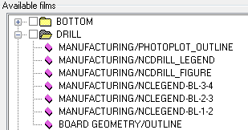
Artwork中的Drill層
MANUFACTURING/NCLEGEND-BL-1-2
MANUFACTURING/NCLEGEND-BL-2-3
MANUFACTURING/NCLEGEND-BL-3-4
不同層的Drill Legend都要出現這樣用CAM軟體才看的到

Slide 15
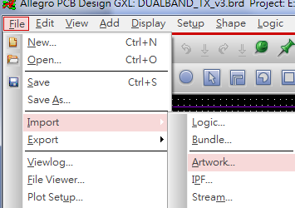
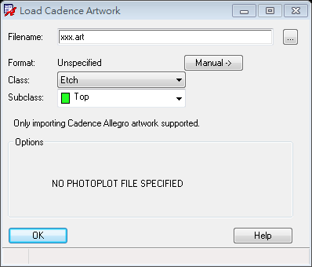
檢查底片
Import Artwork
用CAM軟體去開artwork

Slide 16
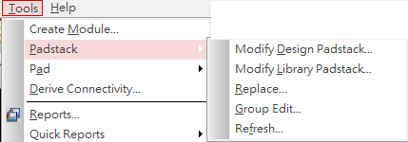
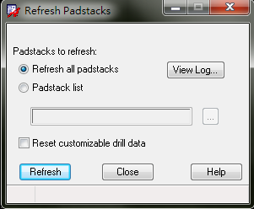
想修改Padstack怎麼辦?
在Tools -> Padstack底下有許多選項可以使用
如果在Pad Designer更改後想要更新可選擇Refresh後,選擇Refresh all padstacks然後按Refresh就會更新囉~

Slide 17
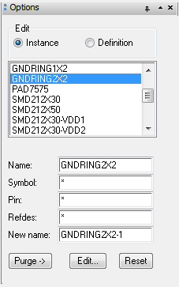
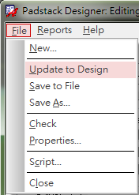
Modify Design Padstack
可以更改板子上曾經用過的Pad
直接在Option的列表中點兩下就可以開始更改了~
如果選Instance就要另存成另外一個新的Pad
選Definition則是可以直接更改原本的檔案
改好之後再Pad Designer 選擇
File -> Update to Design就可以看到更改的結果
另外也要Save to File
Modify Library Padstack
和Modify Design Padstack類似
只是可以更改所有的Padstack

Slide 18
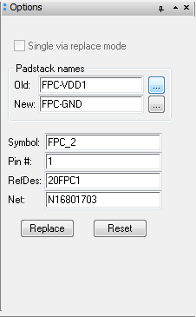
Padstack Replace
可以取代板子上的Pad成其他Pad
除了New:的欄位以外
其他的欄位可以直接點選想要取代的Pad的位置
就會自動填入該有的值了
都點選好後再New的欄位選擇想要取代成的Pad
最後按Replace就完成了~

Slide 19
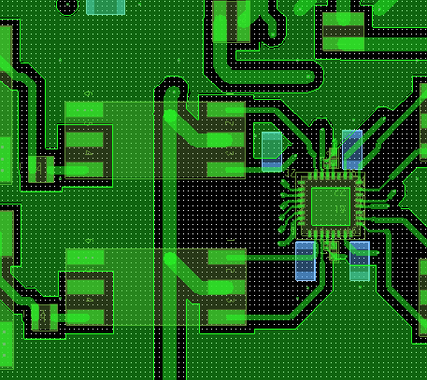
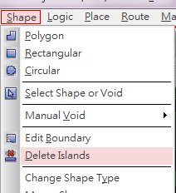
Island removal
紅圈區為自動split plane後island產生的地方
利用 “Delete Islands” 將全部island刪除
或像紅圈上方處利用VIA確保island grounded

Slide 20
Note
從另外板子的外圍要放20mil的AntiEtch。避免板子邊緣的導體外露，造成ESD
可直接用Add -> Rectangle
Subclass選擇要畫的layer(有鋪整層的都要畫)
或選取All
建議全部使用英制單位
GND和VDD之間要加上若干bypass capacitors
不同層的GND要打上若干個via或air bridge以確保GND shape的電位均勻

